Slide 1
Predicting Breast Cancer using Logistic Regression and Neural Networks
By Venkat Rao

Slide 2
Goals
For this project, I wanted to use my fledgling machine learning skills in order to solve a problem in the medical industry. According to the World Cancer Research fund, Breast Cancer is the most common cancer in women, and the second most common type of cancer overall. I decided to try to classify breast tumors into cancerous and non-cancerous. I chose breast cancer because there is lots of data for it because it’s so common. My aim with this project was to train both a logistic regression classifier and a neural network on a dataset of various breast tumors to develop a way to accurately and confidently predict whether a tumor is benign or malignant.

Slide 3
1.7 million
New cases of Breast Cancer per year

Slide 4
Tools
In order to train my neural network and logistic regression classifier to recognize malignant tumors, I needed a dataset with examples of both types tumors for both of my classifiers to look at. I found a dataset published by the University of California, Irvine that had information about many examples of breast tumors. I used GNU Octave, a free and open source programming language in order to make sure that my results could be reproducible.
Link to source code and images from this presentation:

Slide 5
Procedure
First, I formatted the data, removing attributes that didn’t correlate with being malignant or benign. To do this, I plotted histograms of each attribute for malignant and benign tumors. Then, I trained two logistic regression classifiers, which plot the data in many dimensions and try to find a complex surface that separates the benign tumors from the malignant ones. I trained both linear and polynomial logistic regression classifiers. I also tried training a neural network, which is able to learn more complex prediction equations and is modeled after the human brain.

Slide 6
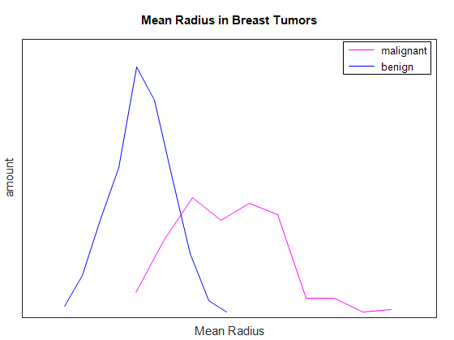
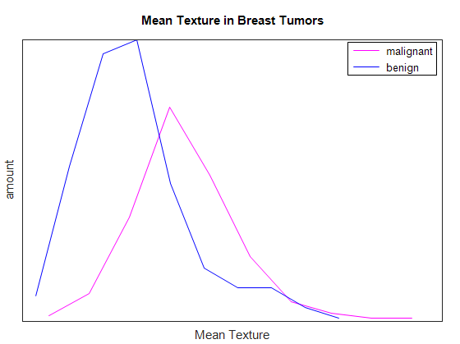
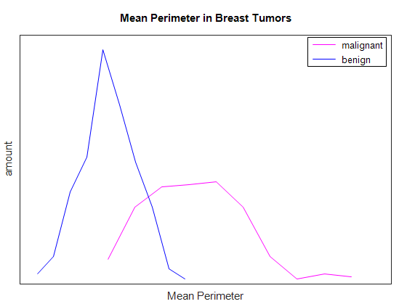
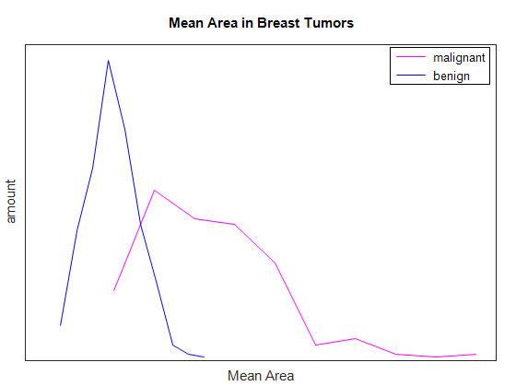
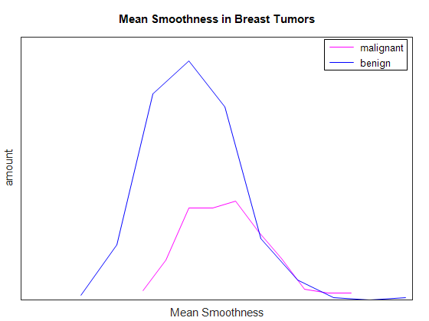
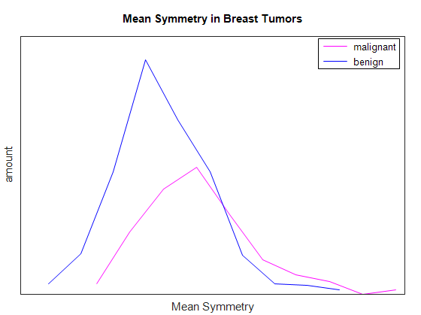
Histograms showing correlation between tumor type and various attributes By looking at which average each attribute is closer to, we can predict whether each tumor is malignant.

Slide 7
Results
I trained the logistic regression classifier using both linear and quadratic regression. Both produced the same quality results. The neural network produced many more false positives than false negatives, which is good because a false positive is better than a false negative. However, the logistic regression classifiers were more accurate overall.
Accuracy of logistic regression (linear): 97.54%
Accuracy of logistic regression (quadratic): 97.54%
Accuracy of neural network: 82.78%

Slide 8
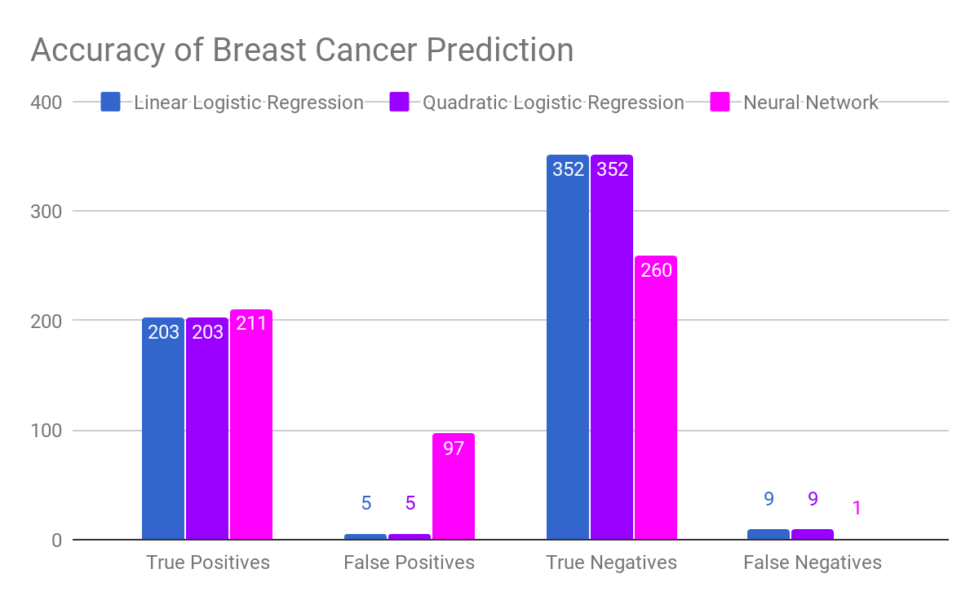

Slide 9
Next Steps
One way to improve these algorithms would be to collect even more data on malignant and benign tumors to further increase accuracy.
These algorithms are general, and would work for other types of cancer as well provided you have good data.

Slide 10
Questions?

